Slide 1
Supporting GP Practices
Community Pharmacy Services

Slide 2
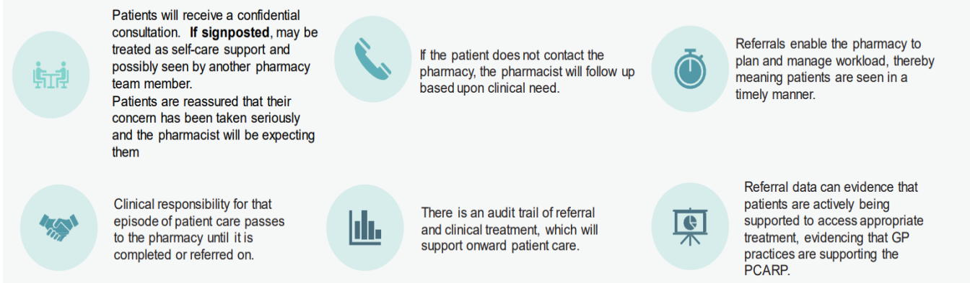

Why formal referrals are required

Slide 3
What about patient ‘bounce backs’ to the practice?
Data shows that from Feb 24 to Mar 25:
ONLY 11% of Pharmacy First Referrals were signposted or escalated back to GP practices*
Escalations backs are often due to red flags or deterioration in the patient’s condition.
This does not mean the service has failed – rather that it is working as expected.
Clinical pathways allow pharmacists to supply specific prescription medicines and reduce onward referrals.
Stronger collaboration between practices and community pharmacists improves the management of bounce backs for practices, pharmacies and ultimately patients.
*Data is taken from Pharmacy First and CPCS dashboard – HWEICB – Mar25

Slide 4
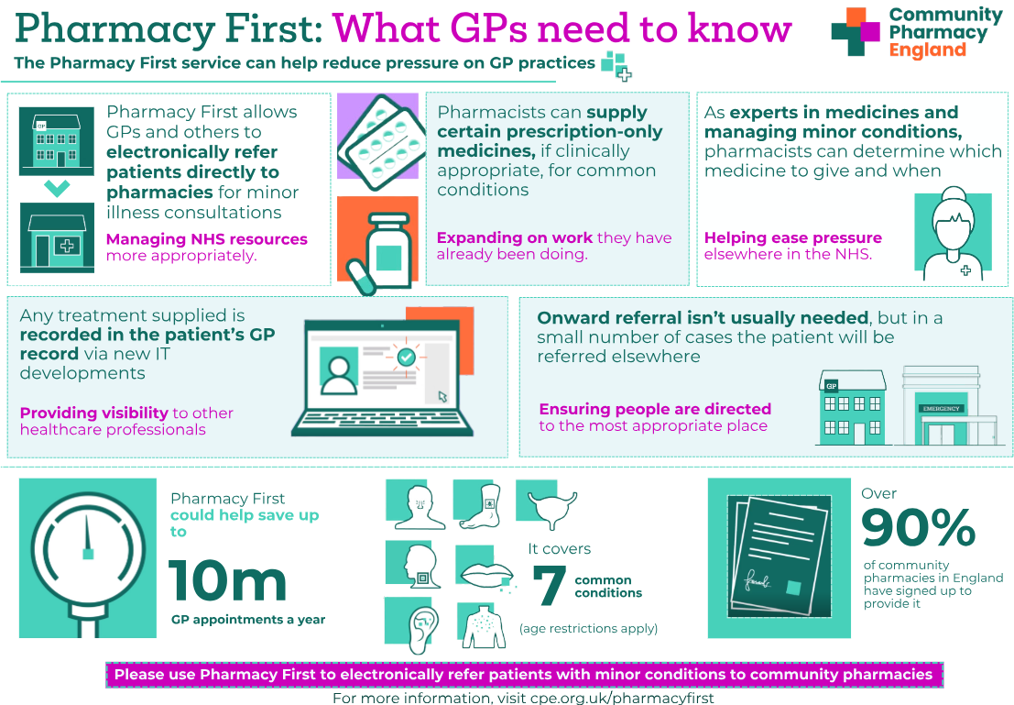
Pharmacy First Service
Management of minor illnesses and 7 common conditions by community pharmacists offering:
  Self-care and safety netting advice
  Supply of a restricted set of medicines (only if appropriate)
  Escalation (only if necessary)
GP practices can electronically refer patients for consultations.
In the minority of cases where the pharmacist is not able to help, the patient will be referred to the appropriate place, such as their GP practice or Emergency department.
96.5%
of Hertfordshire Contractors are signed up to deliver the
Pharmacy First Service
Pharmacies which offer the Pharmacy First Service

Slide 5
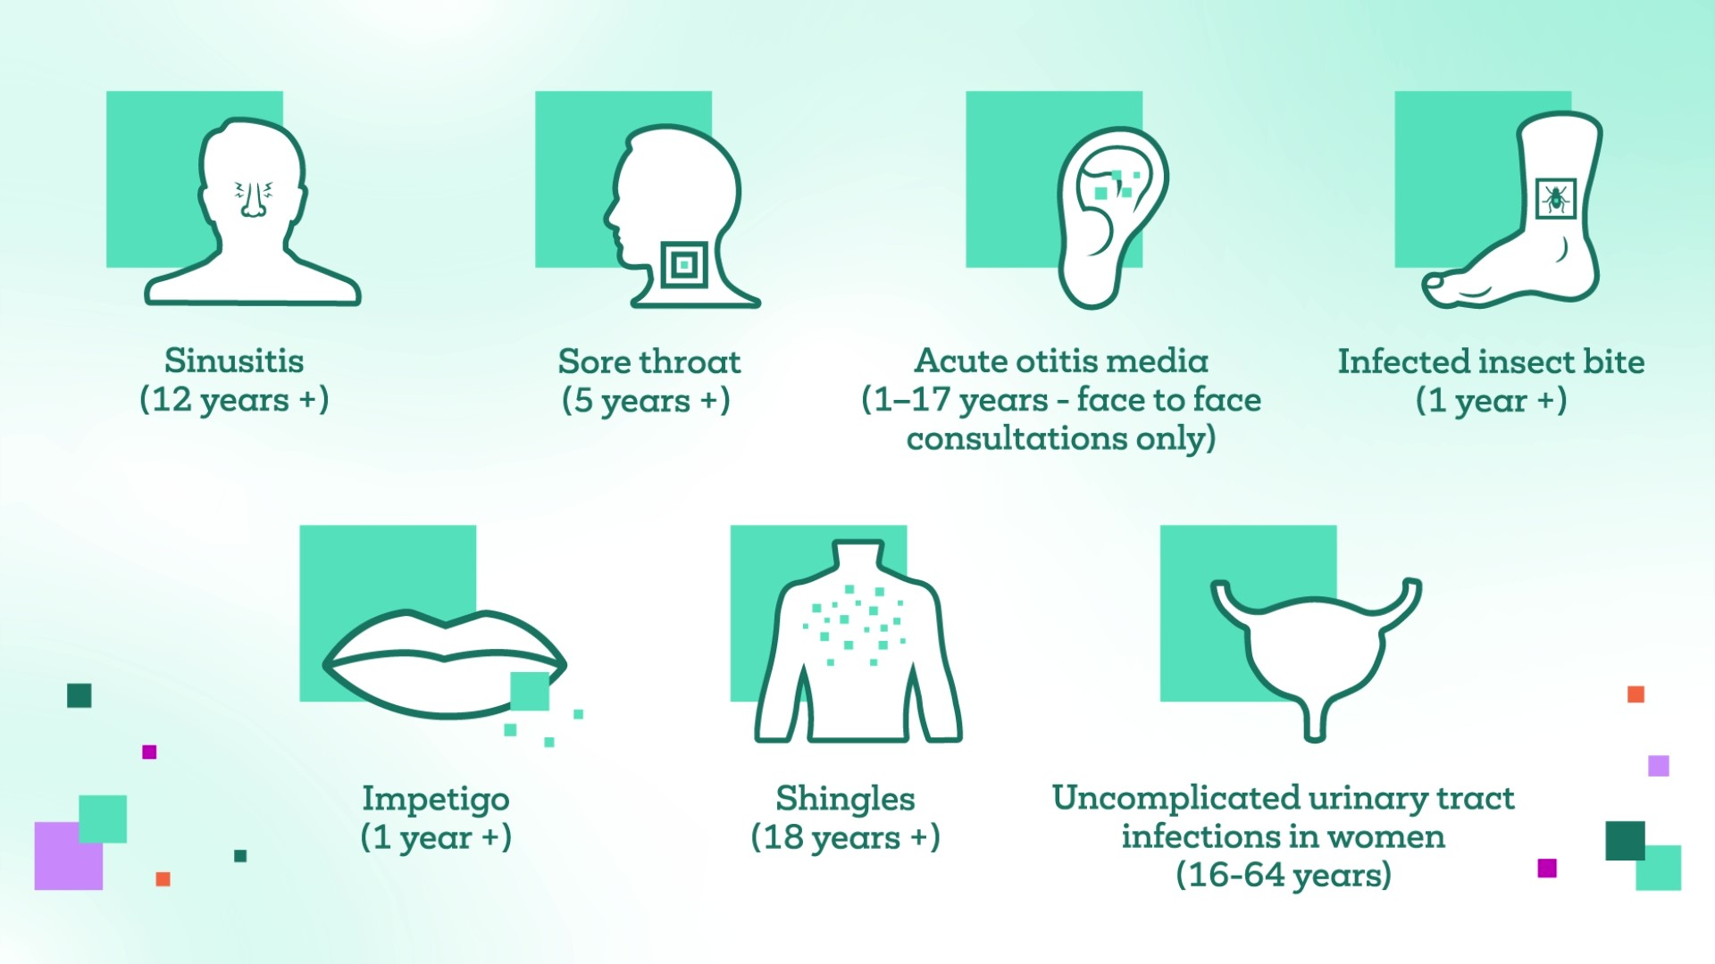
Pharmacy First Service
Minor Illness
Minor ailments and acute self-limiting conditions – directing patients to pharmacists for appropriate advice and treatment.
Clinical Pathways
Assessment and NHS-funded treatment of 7 common conditions through robust PGDs.
Patient’s GP practice will be notified on the day of provision of the service or on the following working day.

Slide 6
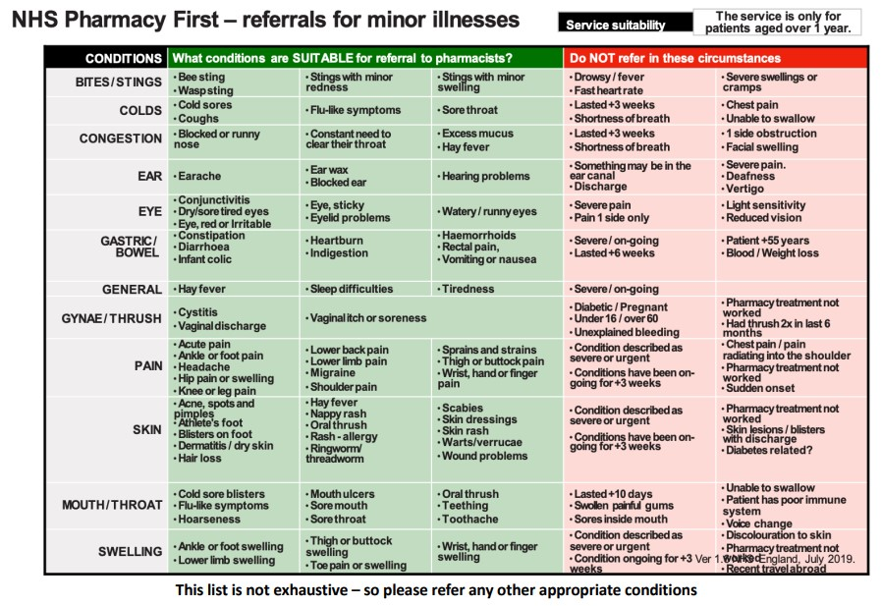

Slide 7
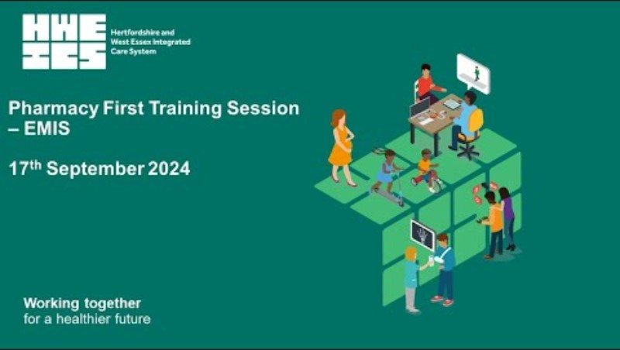
Pharmacy First - EMIS training Webinar
🔗https://youtu.be/hr2ArUSeWPQ
Audience
All clinical and non clinical staff working in GP Practices that use the EMIS system and Community Pharmacies.
Suggested use
Training session which can be used for Protected Time to Learn sessions (PTTL), training new starters or a refresher.

Slide 8
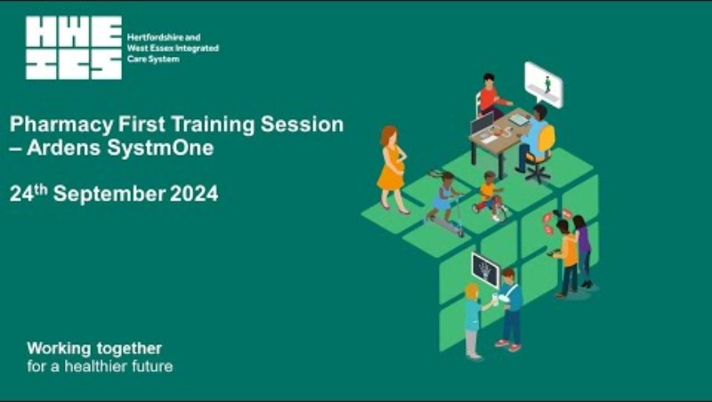
Pharmacy First - Ardens SystmOne training Webinar
🔗https://youtu.be/xgAQOjWKjJM
Audience
All clinical and non clinical staff working in GP Practices that use Ardens SystmOne and Community Pharmacies.
Suggested use
Training session which can be used for Protected Time to Learn sessions (PTTL), training new starters or a refresher.

Slide 9

Pharmacy Contraception Service
This NHS service enables pharmacists to start and monitor routine oral contraception (OC) supplies.
GP practices can sign-post or electronically refer (preferred) eligible patients for consultations.
Where the patient consents, their GP practice will be notified on the day of provision of the service or on the following working day.
From October 2025, subject to the introduction of IT updates, the service will be expanded to include Emergency Hormonal Contraception (EHC).
Pharmacies which offer the NHS Pharmacy Contraception Service

Slide 10
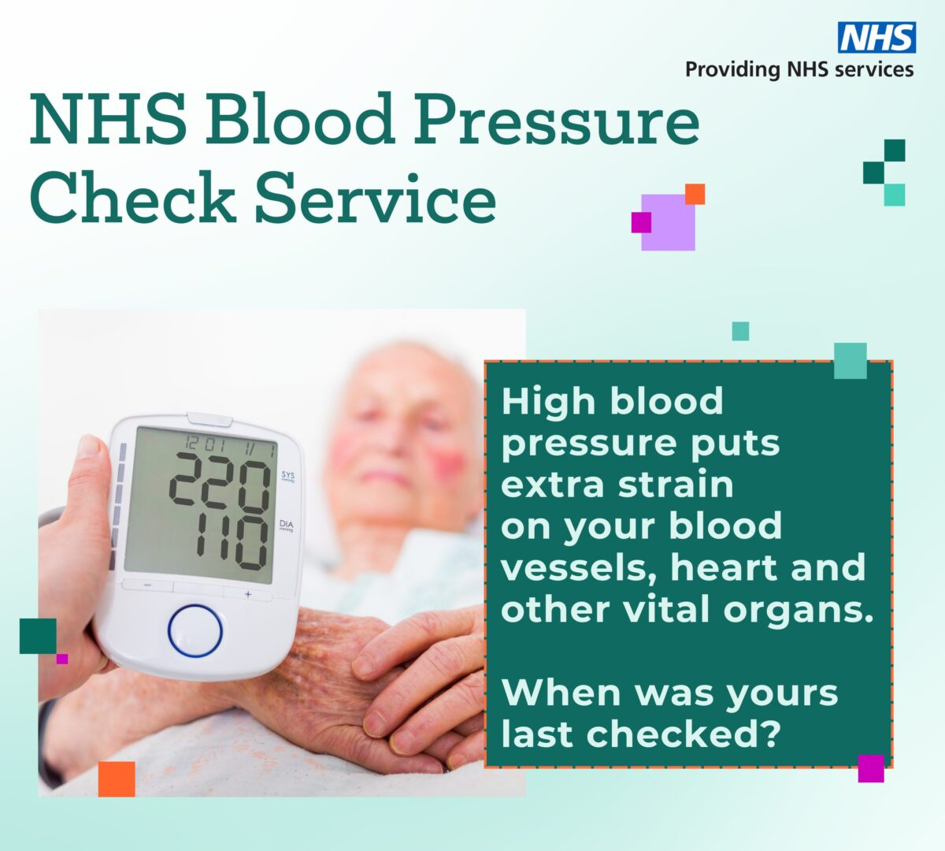
Hypertension Case-Finding Service
Practices can ask pharmacies to complete ambulatory checks on patients with or without a prior diagnosis of hypertension.
Useful for practices with patients with a high initial reading who need ambulatory follow up.
All readings will be returned to the practice for updating patient records.
Pharmacies which offer free Blood Pressure Checks

Slide 11
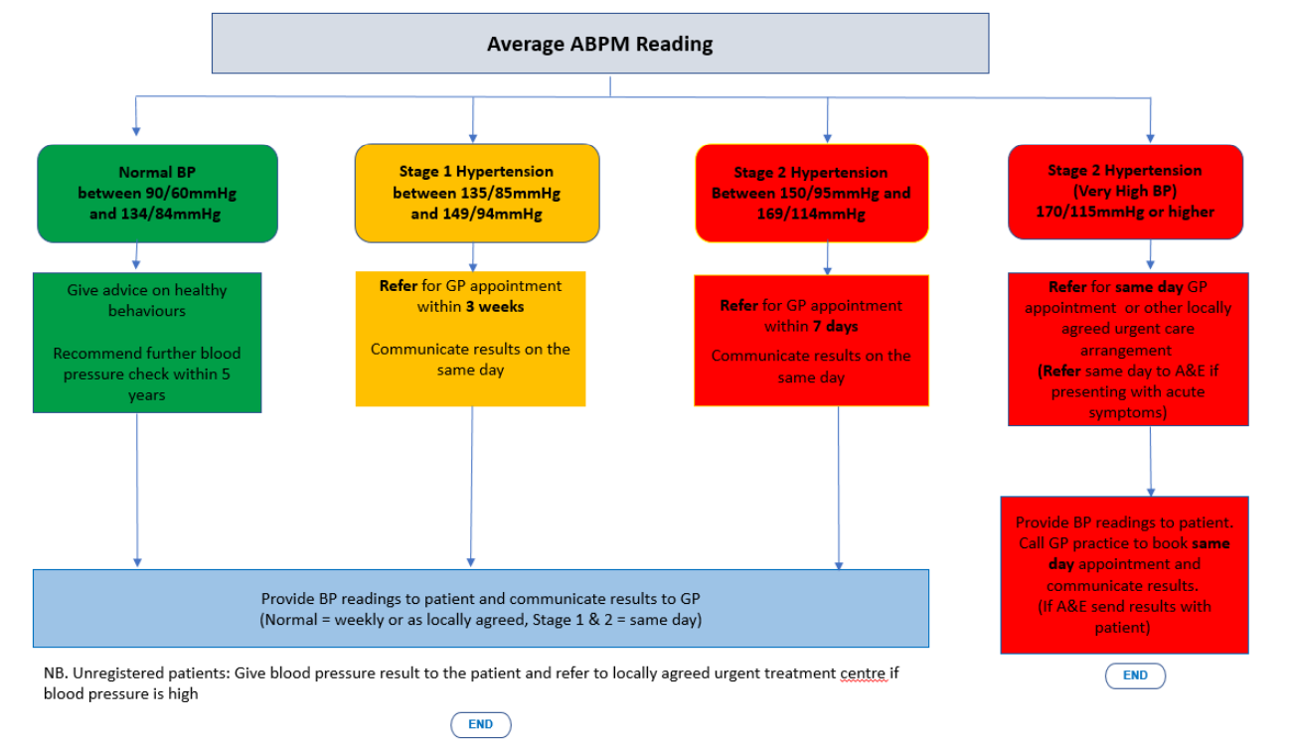

Slide 12
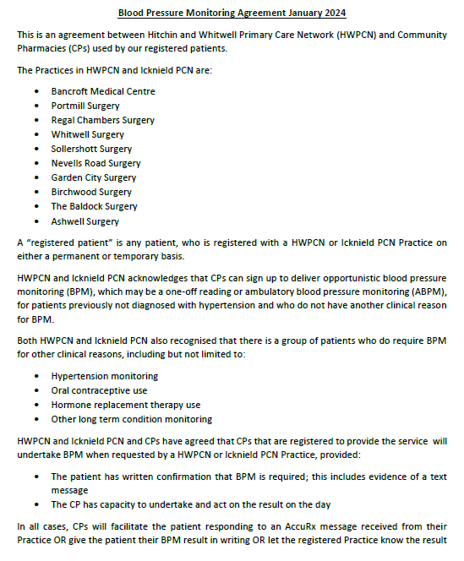

Hypertension Case-Finding Service: Successful Approaches
An effective example of PCN – Community Pharmacy collaboration

Slide 13
Community Pharmacy - Additional Resources
Pharmacy First Service
Pharmacy ContraceptionService
Hypertension Case-Finding Service
Pharmacy First – CPE Information for GP practice teams
HWE Training Hub: Pharmacy First
HWE Training Hub: Decision Aid for Pharmacy First Referrals
HWE Training Hub: Pharmacy First – A summary for General Practice Teams
Pharmacy First Service -(Previously CPCS) : Ardens
Pharmacy First -EMIS referrals
Briefing for general practice and sexual health clinic teams: NHS Pharmacy Contraception Service
HWE Training Hub: Pharmacy Contraception Service
Case study: Pharmacy contraception service – growing people’s confidence in local NHS care
Briefing for general practice teams: The Community Pharmacy Hypertension Case-Finding Service
HWE Training Hub: NHS Community Pharmacy Blood Pressure Check Service

